Slide 1

Safeway Online Order
Group 4: Juzheng Shi, Yan(Yancey) Ding

Slide 2

Agenda
Business Scenario Description
Swim-Lane Diagram
Entity Relationship Diagram
Queries
Visualization
Conclusion

Slide 3
Business Senario Description
William, who lives a busy and healthy life, orders groceries online and picks them up at the store curb on his way home to make a nice home dinner for himself. It is 4pm Friday. William takes out his phone and opens the Safeway Drive Up & Go app. He picks yogurt, eggs, asparagus, and steak, and pays at the checkout. He chooses 6pm to pick up at the Safeway which is 1 mile away from his house.
Jason, who works at Safeway, receives William’s order. At 5:30, Jason goes to each aisle and picks the groceries that William ordered and packs and places at the to-go counter.
At 6pm, William arrives in the Safeway parking lot, pickup spot 1, and confirms his arrival and parking spot on the Safeway app. Jason sees William’s arrival, brings the grocery bag to William’s car, and loads into the truck.
When William gets home, he receives a message from Safeway asking for his feedback. William is satisfied with the service, so he gives a 5-star to this shopping experience.

Slide 4
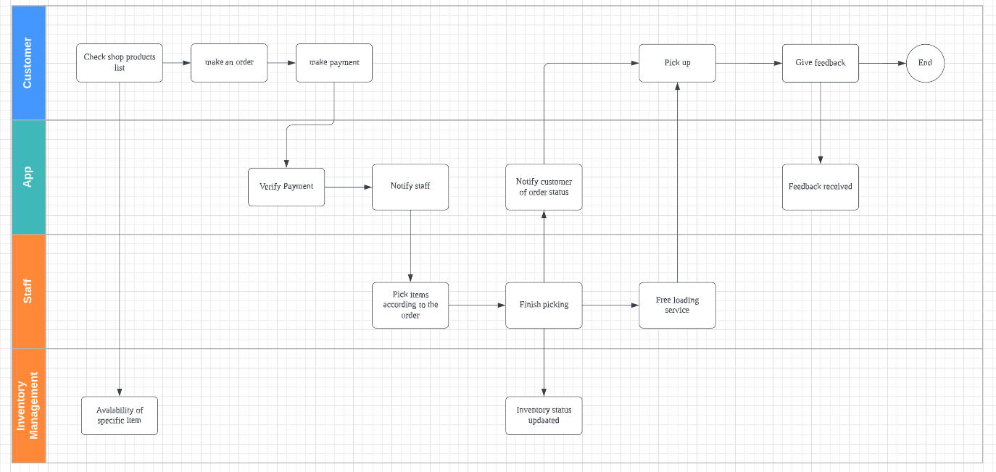
Swimming Lane Diagram

Slide 5
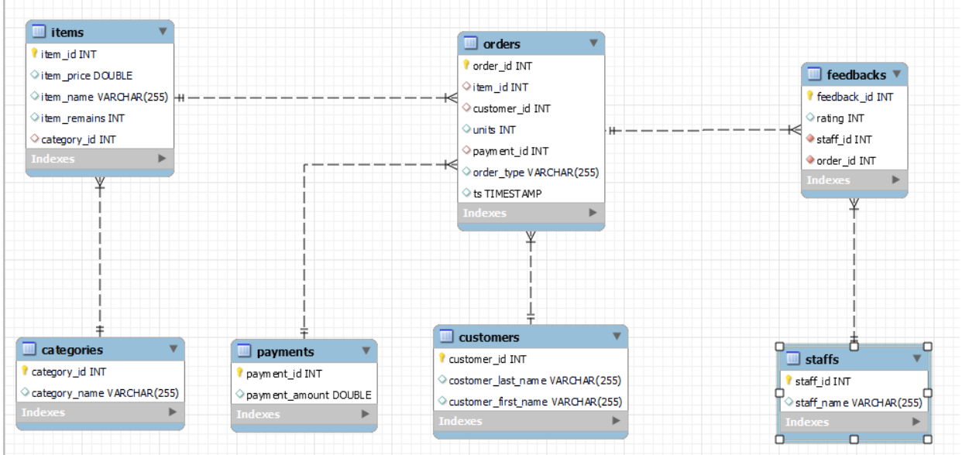
ER Diagram

Slide 6
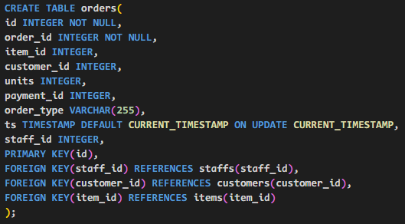
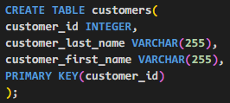
Table Creation - Orders & Customers

Slide 7
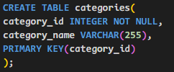
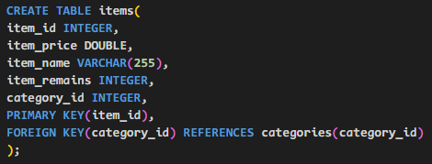
Table Creation
- Categories & Items

Slide 8
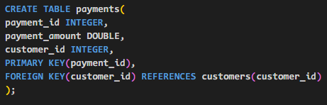
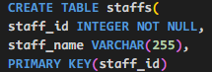
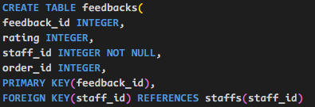
Table Creation - Payments Staff Feedback

Slide 9
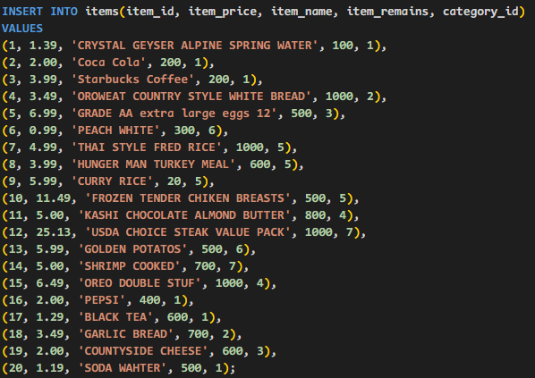
Insert Data - into Items table

Slide 10
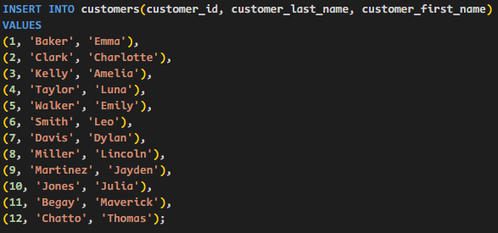
Insert Data - into Customers table

Slide 11
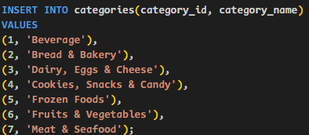
Insert Data - into Categories table

Slide 12
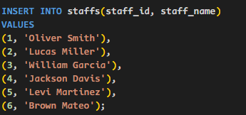
Insert Data - into Staff table

Slide 13
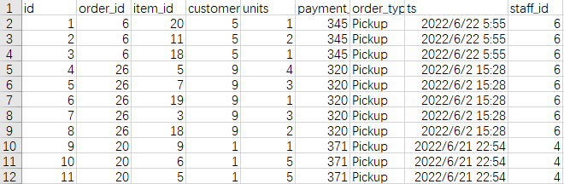
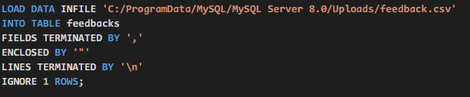
Load Order Data via CSV File

Slide 14
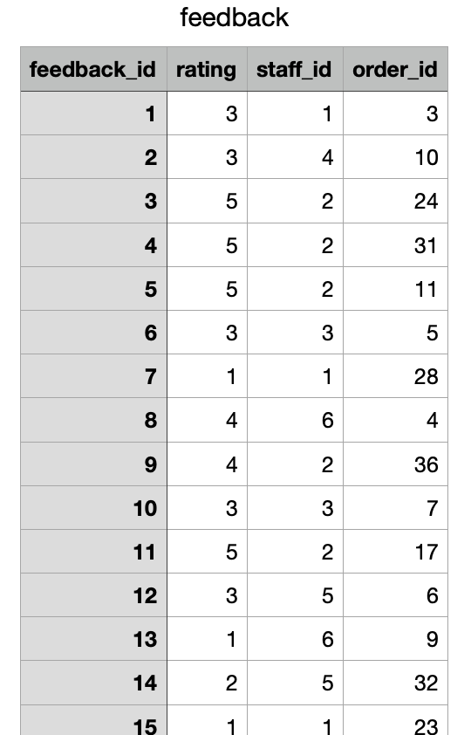
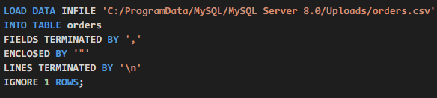
Load Feedback Data via CSV File

Slide 15
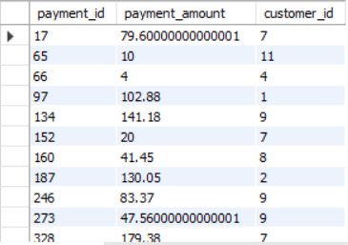
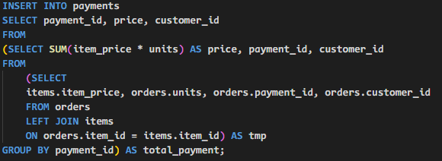
Insert Data - into Payment table

Slide 16
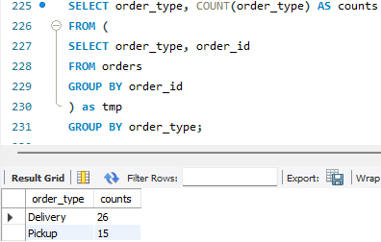
Order Type Count Without Join

Slide 17
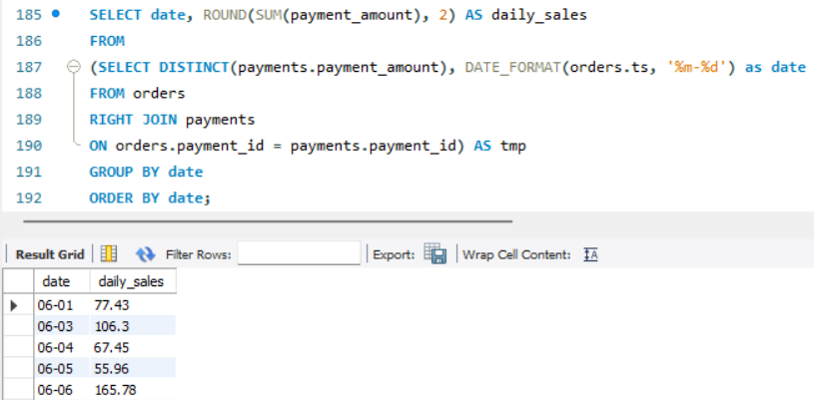
Sales per Day

Slide 18
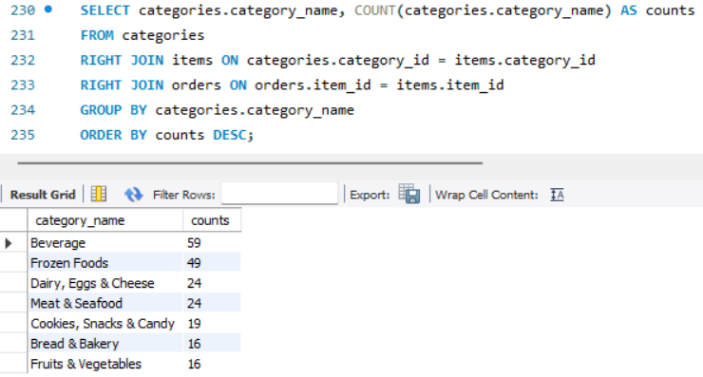
Sales per Category

Slide 19
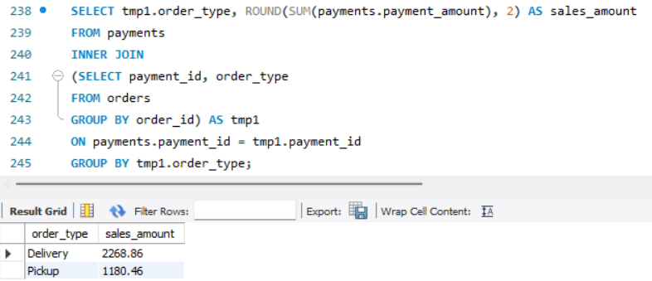
Sales per Order Type

Slide 20
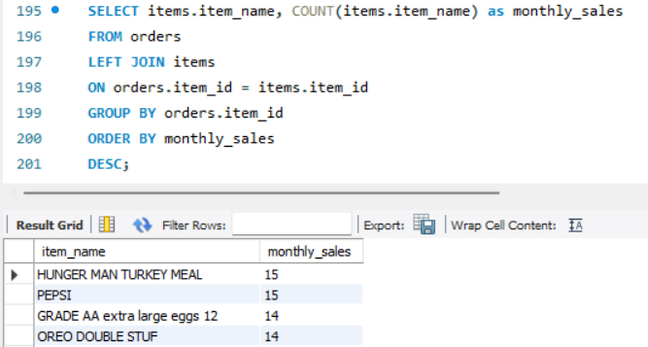
Sales per Item

Slide 21
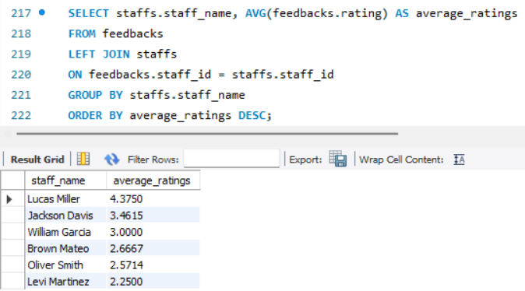
Staff Rating

Slide 22
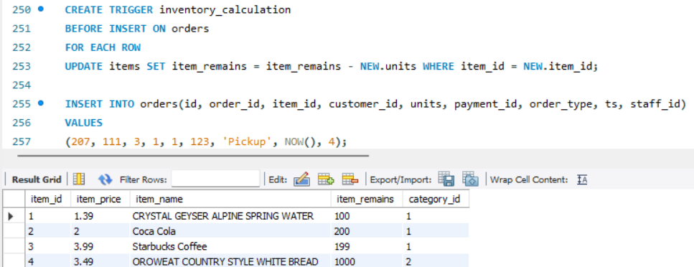
Trigger

Slide 23
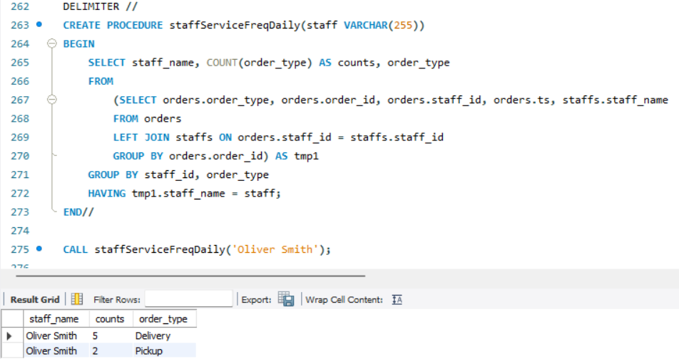
Procedure

Slide 24
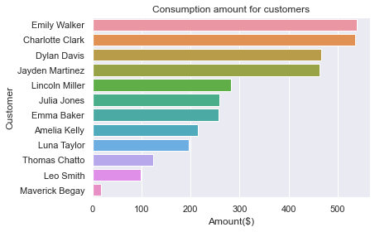
Spending per Individual Customer

Slide 25
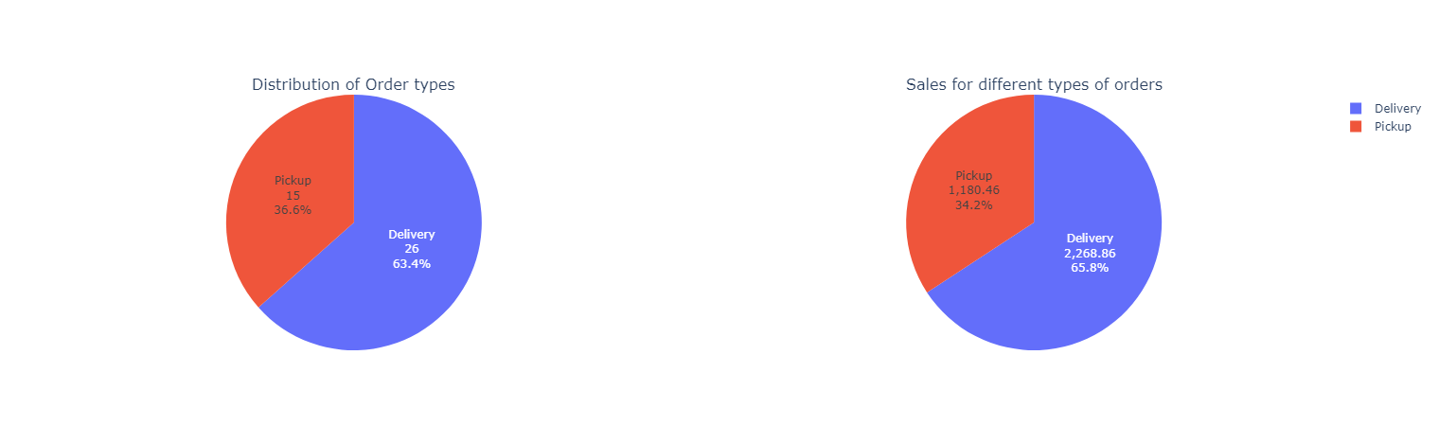
Delivery is preferred for distribution.

Slide 26
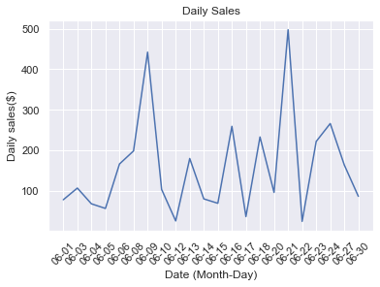
Sales revenue fluctuates each day.

Slide 27
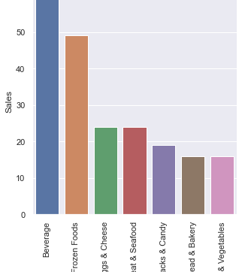
Sales per Category

Slide 28
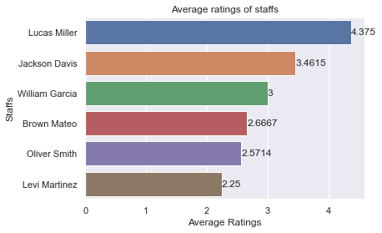
Staff Performance

Slide 29
Conclusion
The project helped us walk through a business activity, from identifying the topic, mapping out the process to identify the sales revenue per day, per product item, and per product category.
It is a small data sample from the month of June. Therefore, our analysis is unable to reflect the demand for seasonal products.

Slide 30

Thank you.

